Slide 1
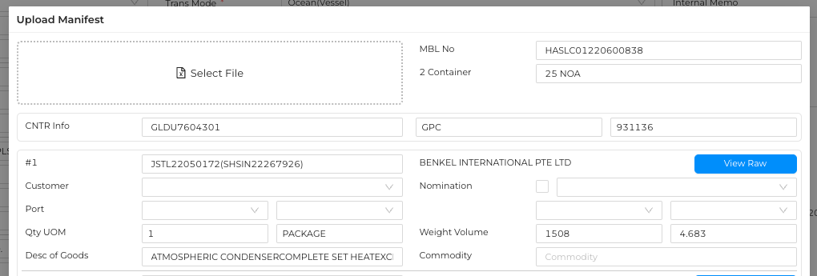

1 Containers 14 NOA
Show size text on text box
Let user to select proper Code on Drop down
Show blank
And Show it with label after read xml

Slide 2
